Slide 2
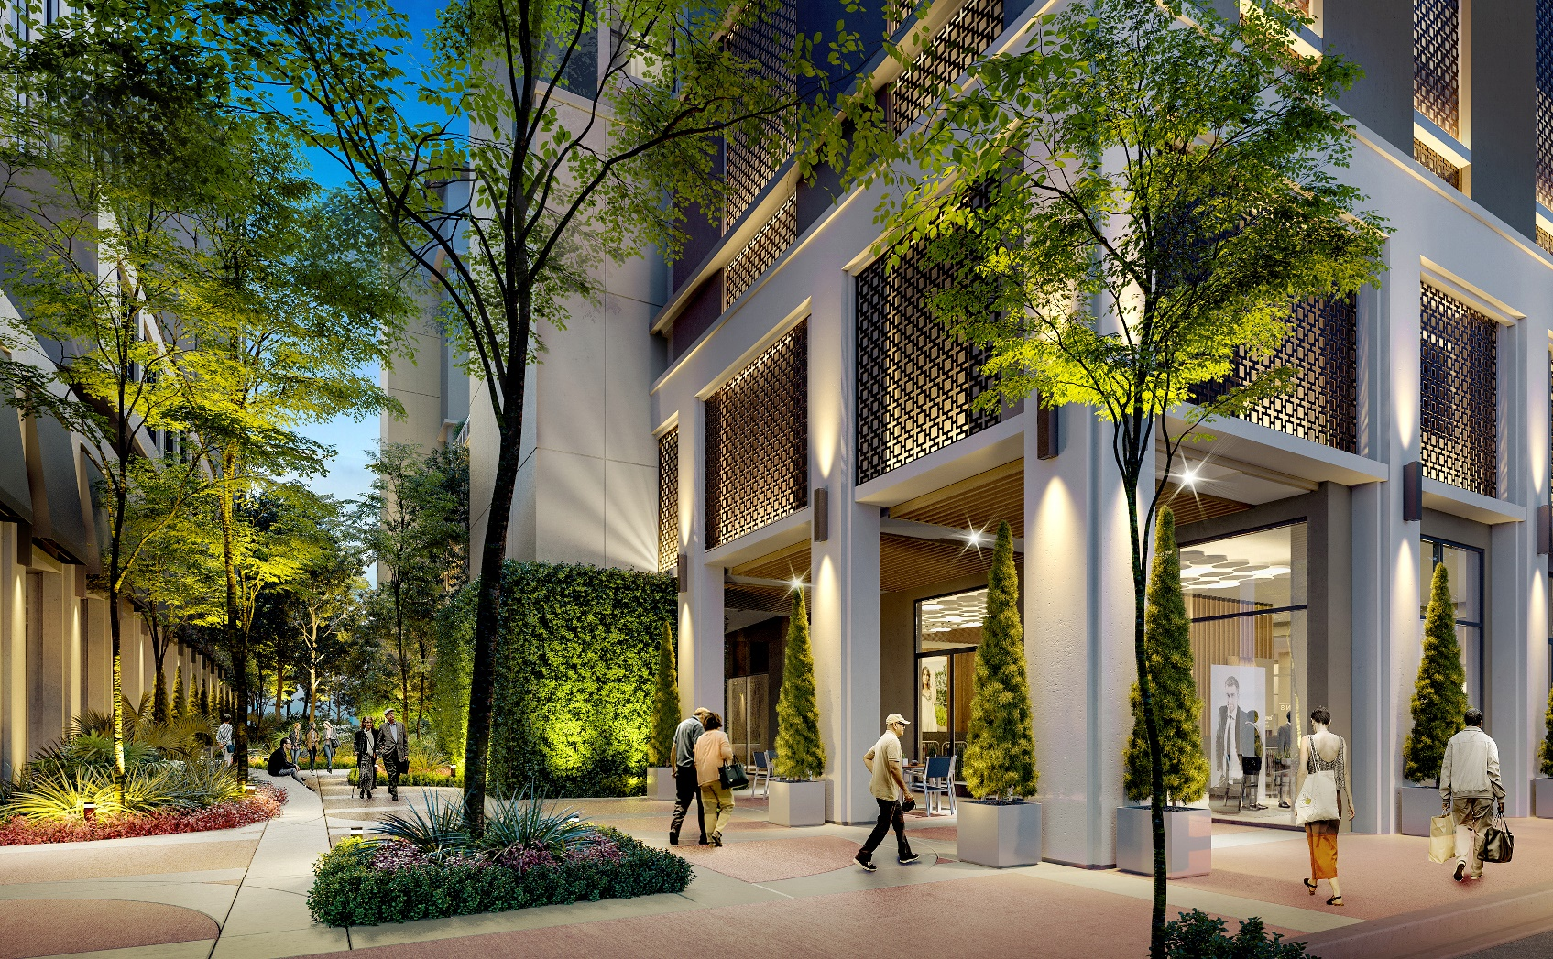
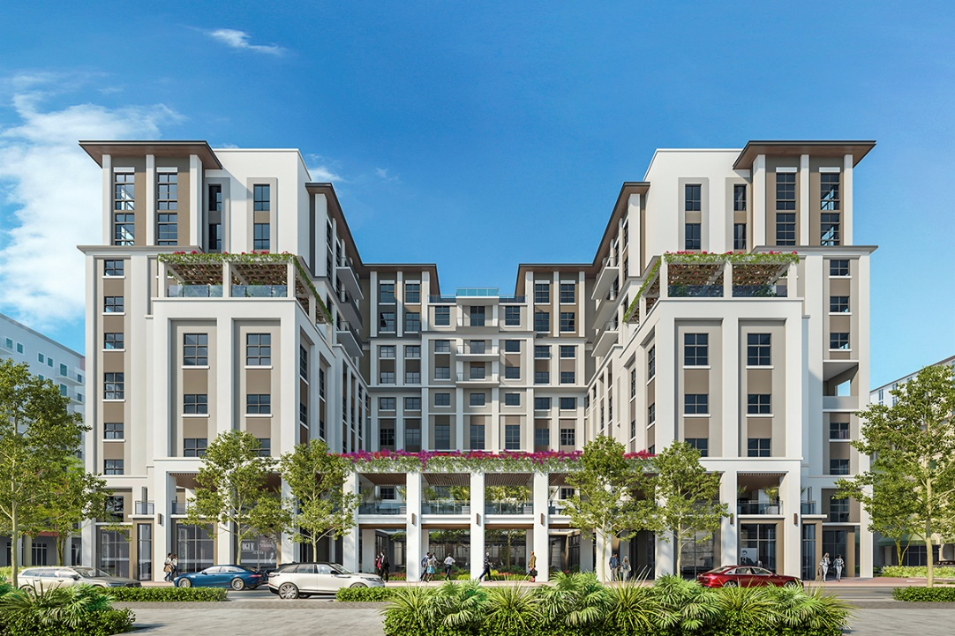
Belmont Village Coral Gables, Miami-Dade County, Florida
In Affiliation with Baptist Health South Florida
Opening 2023

Slide 3
Belmont Village Coral Gables, Miami-Dade County, Florida
In Affiliation with Baptist Health South Florida
Opening 2023

Slide 4
Belmont Village La Jolla, San Diego, California
In Affiliation with Greystar Real Estate Partners
Opening 2022

Slide 5
Belmont Village La Jolla, San Diego, California
In Affiliation with Greystar Real Estate Partners
Opening 2022

Slide 6
Belmont Village Los Gatos, San Diego, California
Opening 2022

Slide 7
Belmont Village Los Gatos, San Diego, California
Opening 2022

Slide 8
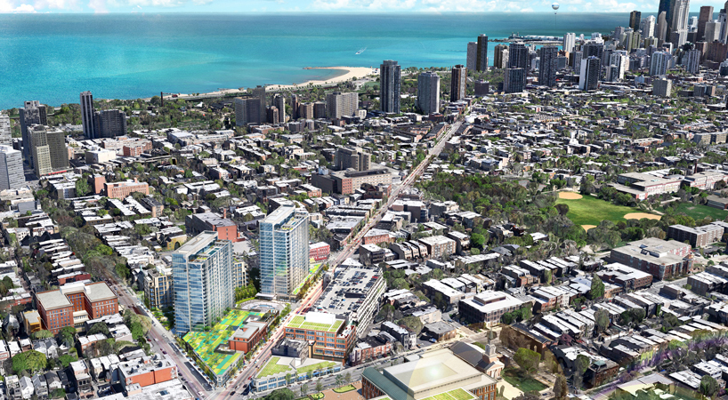
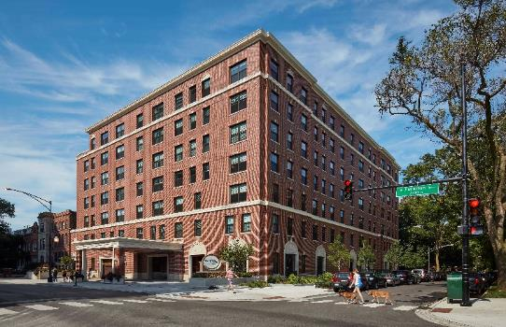
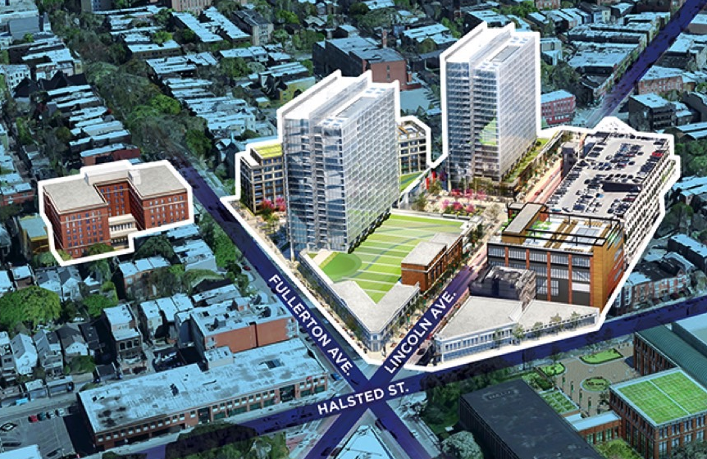
Belmont Village Lincoln Park, Chicago, Illinois
In Affiliation with McCaffery and the Lincoln Commons
Opened 2019

Slide 9
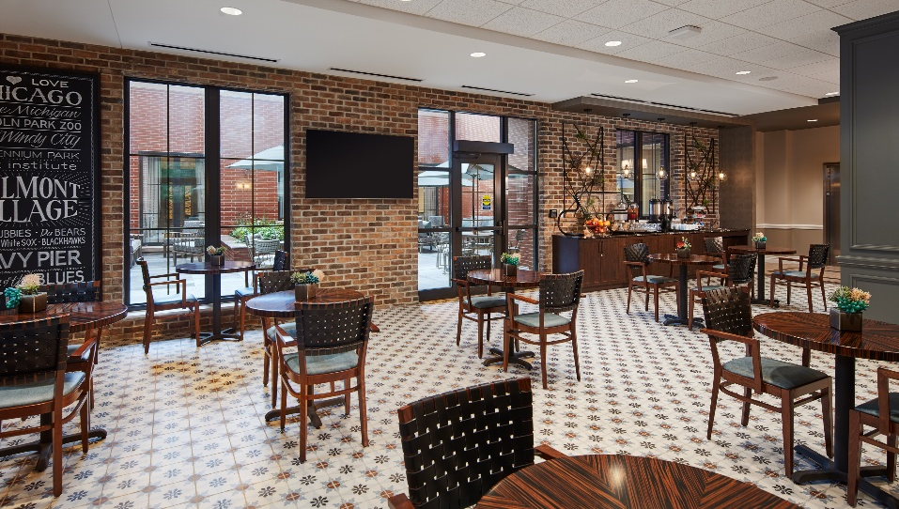
Belmont Village Lincoln Park, Chicago, Illinois
In Affiliation with McCaffery and the Lincoln Commons
Opened 2019

Slide 10
Belmont Village Albany, Albany, California
in Affiliation with UC Berkeley
Opened 2017

Slide 11
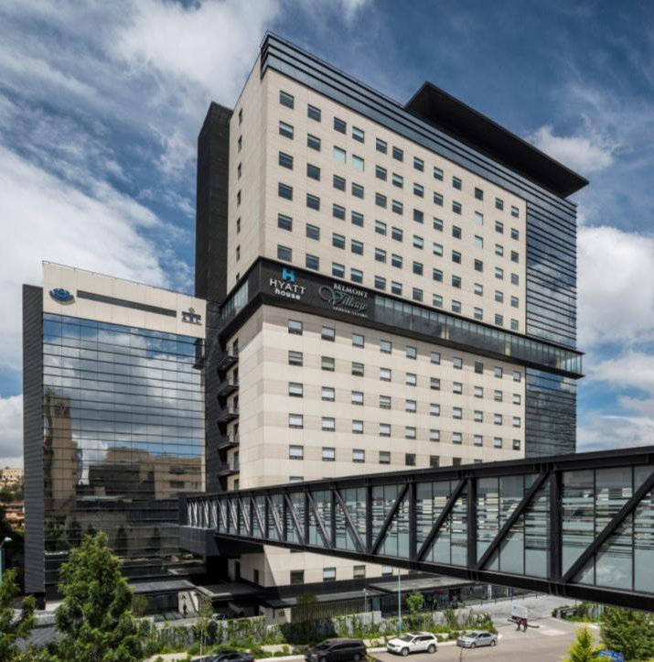
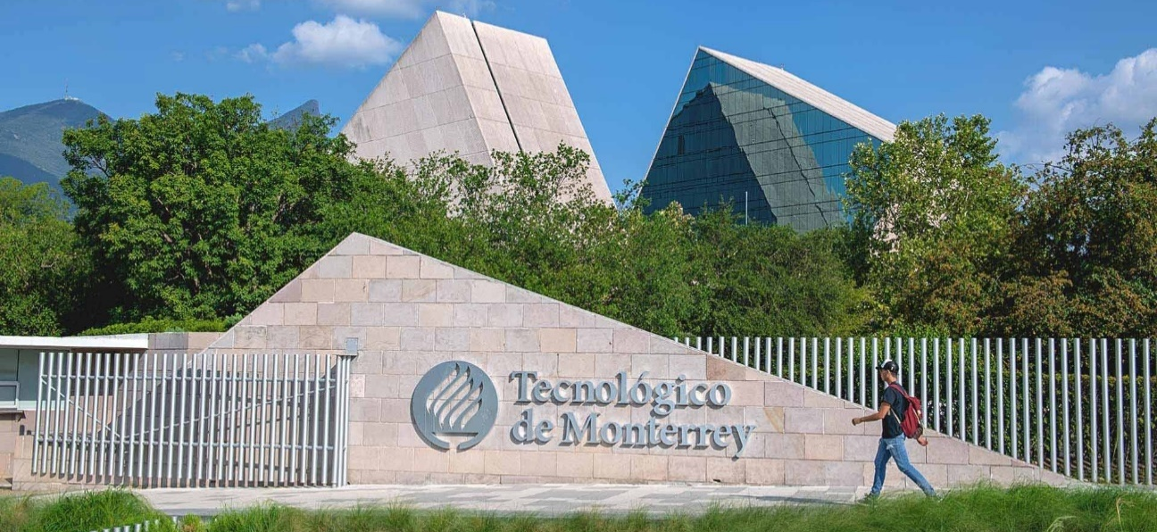
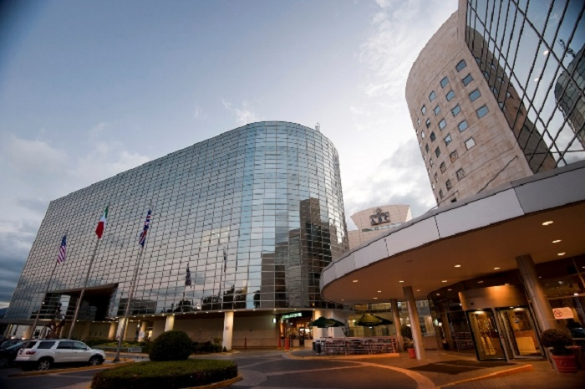
Belmont Village Santa Fe, Mexico City, Mexico
In Affiliation with ABC Centro Medico
Opened 2017

Slide 12
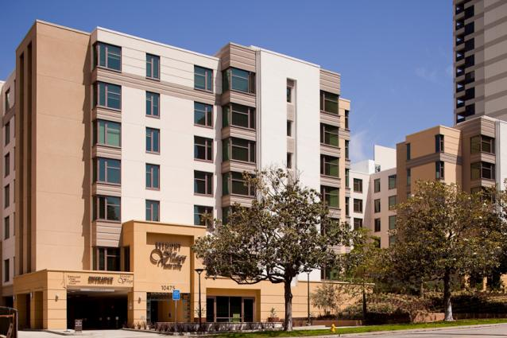
Belmont Village Westwood, Los Angeles, California
in Affiliation with UCLA
Opened 2009

